Slide 1
Chapter 5
KNOWLEDGE REPRESENTATION
Cios / Pedrycz / Swiniarski / Kurgan

Slide 2
Outline
Introduction
Main categories of data representation schemes
Granularity of data and its taxonomy
Design aspects
© 2007 Cios / Pedrycz / Swiniarski / Kurgan

Slide 3
Knowledge Representation
Sources of knowledge are highly heterogeneous and need to be represented in different ways
Representation is essential for data processing and revealing relationships
Granularity of information is a means of abstraction, essential in description of relationships found through data mining
© 2007 Cios / Pedrycz / Swiniarski / Kurgan

Slide 4

Data Types: Continuous Quantitative Data
Continuous variables, such as pressure, temperature, and height
They often have some relationship to the physical phenomena that generated them, such as linear order
© 2007 Cios / Pedrycz / Swiniarski / Kurgan

Slide 5
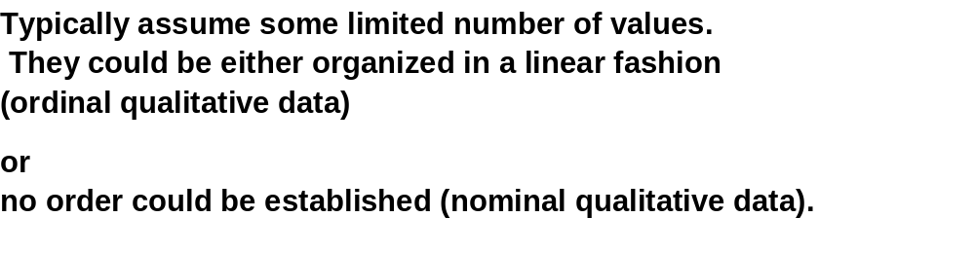


Data Types: Qualitative Data
© 2007 Cios / Pedrycz / Swiniarski / Kurgan

Slide 6
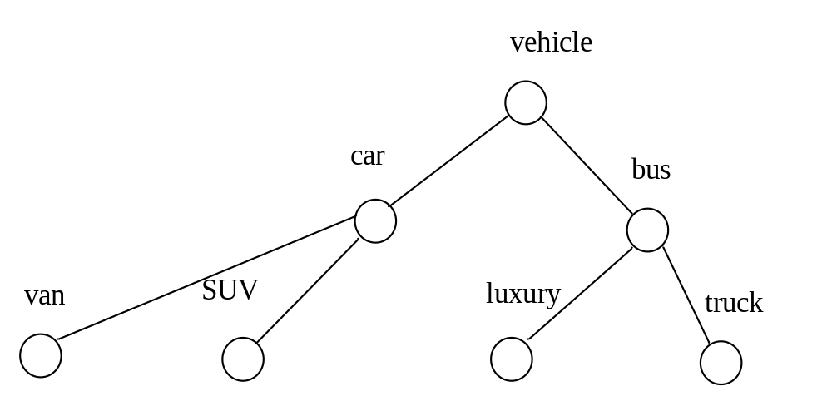
Structured Data
They form some structure that leads to a hierarchy of concepts
More specialized concepts occur at lower level of hierarchy
Tree structure is commonly used for their representation
© 2007 Cios / Pedrycz / Swiniarski / Kurgan

Slide 7
Models of Knowledge Representation
Rules
Graphs and directed graphs
Trees
Networks
© 2007 Cios / Pedrycz / Swiniarski / Kurgan

Slide 8
Rules and their Taxonomy
Generic format
IF condition THEN conclusion (action)
In general, we have a finite collection of rules
IF condition is A_{i} THEN conclusion is B_{i}
Often the rules are multivariable, namely, they consist of
a number of variables (conditions)
- IF condition₁ and condition₂ and …. and condition_{n} THEN conclusion
© 2007 Cios / Pedrycz / Swiniarski / Kurgan

Slide 9
Gradual Rules
“The higher the values of condition, the higher the values of conclusion”
or
“the lower the values of condition, the higher the values of conclusion”
They capture notion of graduality between the concepts
occurring in the conditions and conclusions
IF τ(A_{i}) THEN μ(B_{i})
© 2007 Cios / Pedrycz / Swiniarski / Kurgan

Slide 10
Quantified Rules
Quantification of confidence in the rules
the likelihood that high fluctuations in real estate prices
lead to a significant migration of population within the province
is quite moderate.
Confidence of the rule
© 2007 Cios / Pedrycz / Swiniarski / Kurgan

Slide 11
Analogical Rules
Focus on analogy (similarity, closeness, resemblance…)
between conditions and conclusions
IF similarity (A_{i}, A_{j}) THEN similarity (B_{i}, B_{j})
express analogy
© 2007 Cios / Pedrycz / Swiniarski / Kurgan

Slide 12
Rules with Regression Local Models
More advanced and functionally augmented conclusion part
of the rule. It involves some regression model
IF condition is A_{i} THEN y = f_{i}(x, a_{i})
local regression model
© 2007 Cios / Pedrycz / Swiniarski / Kurgan

Slide 13
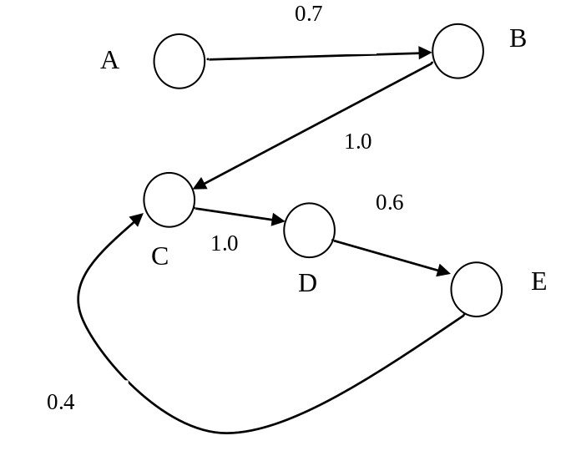
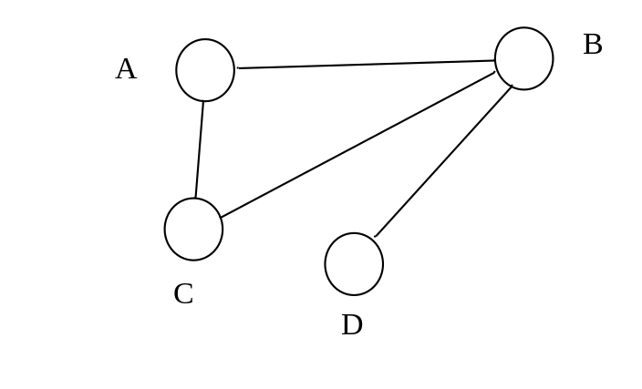
Graphs and Directed Graphs
Concepts (nodes) and links express relationships between the concepts. Two main categories of graphs:
- undirected graphs
- directed graphs
© 2007 Cios / Pedrycz / Swiniarski / Kurgan

Slide 14
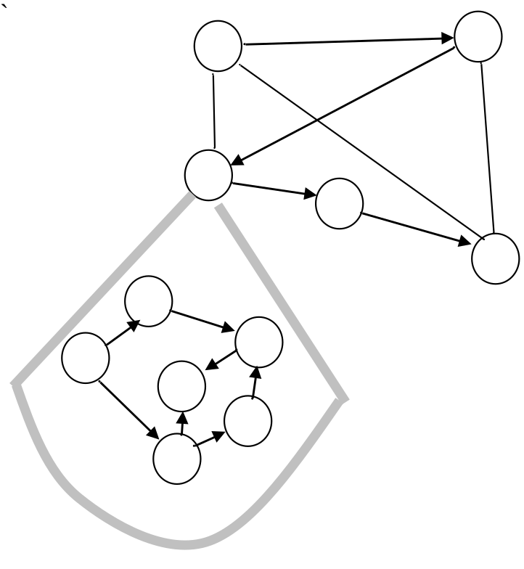
Hierarchy of Graphs
Refinement of relationships starting from the most general
relationships (general nodes) and expansion of the nodes
© 2007 Cios / Pedrycz / Swiniarski / Kurgan

Slide 15
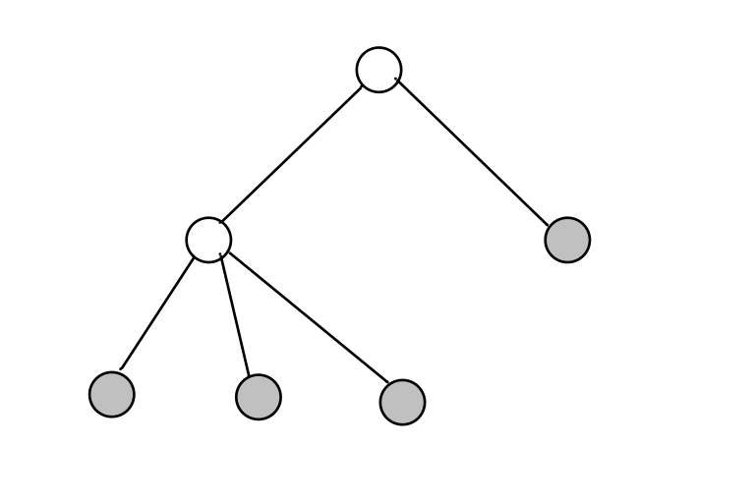
Trees
An important category of graphs with
Single root
No loops
Terminal nodes
root
Terminal nodes
© 2007 Cios / Pedrycz / Swiniarski / Kurgan

Slide 16
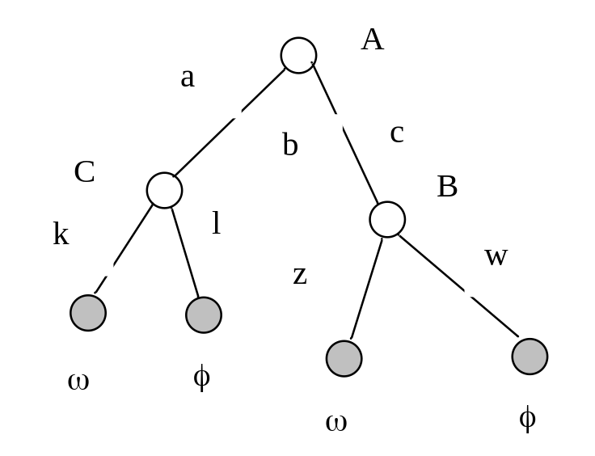
Decision Trees
Decision tree → rules
IF A is c and B is w THEN φ
IF A is c and B is z THEN ω
IF A is a and C is k THEN ω
IF A is a and C is l THEN φ
© 2007 Cios / Pedrycz / Swiniarski / Kurgan

Slide 17
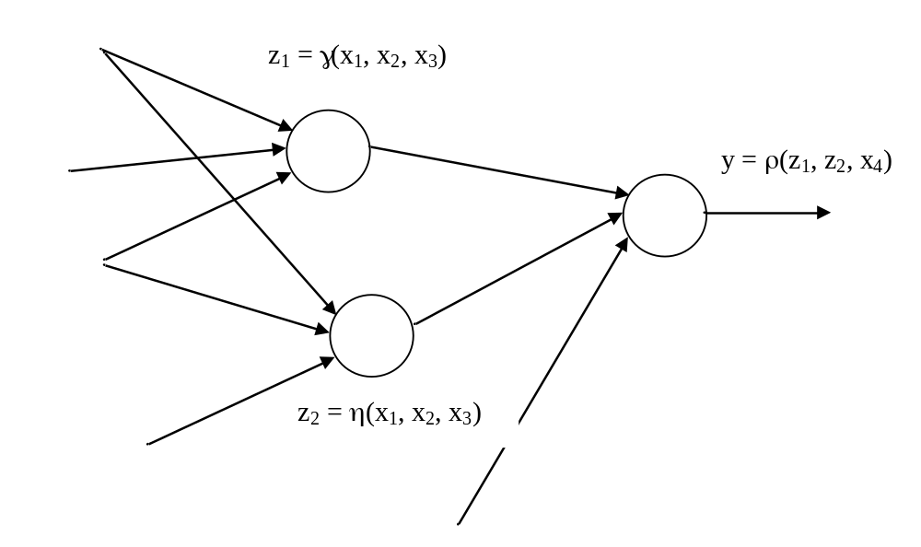
Networks
Generalized graphs with nodes endowed with some
processing capabilities
For instance:
Each node computes some logic formula using input variables and
logic operators (conjunction, disjunction, complement)
(b) Node could be a local neural network
© 2007 Cios / Pedrycz / Swiniarski / Kurgan

Slide 18
Information Granularity
Information granules support human-centric computing
By human-centricity we mean computing systems that facilitate interaction with humans either by improving the quality of communication of findings or
by accepting inputs from users in a friendly manner, e.g., in a linguistic form.
Information granules permeate human endeavors. Any given task can be cast into a certain conceptual framework of relevant generic entities where we:
formulate generic concepts at some level of abstraction
carry out processing
communicate the results to the user
© 2007 Cios / Pedrycz / Swiniarski / Kurgan

Slide 19
Information Granules: Examples
Image processing
Humans do not focus on individual pixels but group them together into
semantically meaningful constructs such as:
regions that consist of groups of pixels drawn together owing to their
proximity in the image, similar texture, color, level of brightness, etc.
Signal processing
We describe signals in a semi-qualitative manner by identifying specific regions
of the signals in time or frequency domain.
E.g., specialists easily interpret ECG signals by identifying some segments
and their combinations.
© 2007 Cios / Pedrycz / Swiniarski / Kurgan

Slide 20
Granular Computing
Identifies essential commonalities between diverse problems and technologies, cast into a framework called a granular world.
With granular processing we can better understand the role of interaction between various formalisms and visualize a way in which they communicate.
It brings together the formalisms of sets, fuzzy sets and rough sets, that in spite of their distinct underpinnings establishes an environment for building synergy between different approaches.
© 2007 Cios / Pedrycz / Swiniarski / Kurgan

Slide 21


Granular Computing: Key Frameworks
Set theory (including interval analysis)
Fuzzy Sets
Rough Sets
Notion of Membership
belongs to excluded from
© 2007 Cios / Pedrycz / Swiniarski / Kurgan

Slide 22
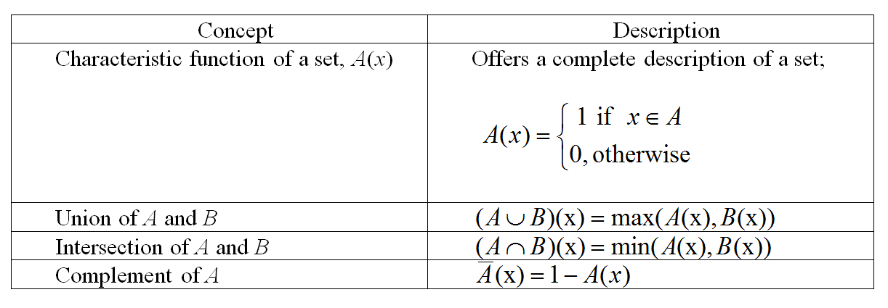
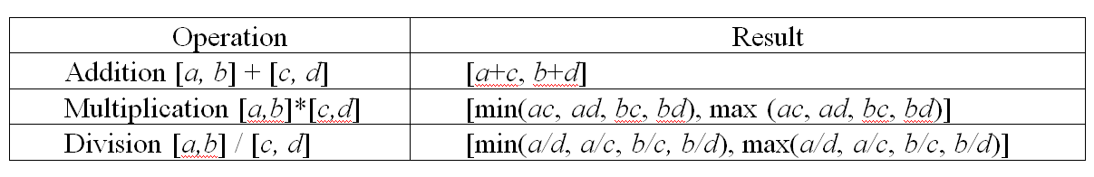
Operations on numeric intervals
© 2007 Cios / Pedrycz / Swiniarski / Kurgan

Slide 23


Characteristic Functions
Concept of dichotomy
© 2007 Cios / Pedrycz / Swiniarski / Kurgan

Slide 24
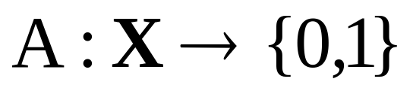
Description of Sets
Membership
  enumerate elements belonging to the set
Characteristic function
1
A(x)=0
0
A(x)=1
© 2007 Cios / Pedrycz / Swiniarski / Kurgan

Slide 25
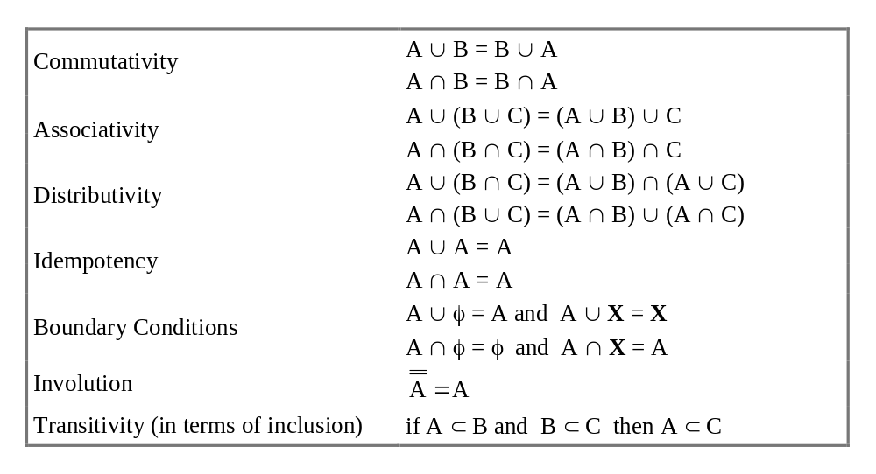
Basic Operations on Sets
© 2007 Cios / Pedrycz / Swiniarski / Kurgan

Slide 26
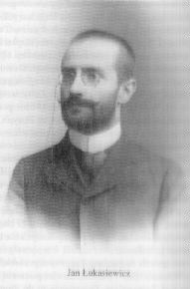
Three-valued Logic
Lukasiewicz (~1920)
true (0)
false (1)
don’t know (1/2)
Three valued logic
© 2007 Cios / Pedrycz / Swiniarski / Kurgan

Slide 27

Fuzzy set - Definition
Fuzzy set A is described by its membership function A(x)
A(x) =1: complete membership
A(x) =0: complete exclusion
© 2007 Cios / Pedrycz / Swiniarski / Kurgan

Slide 28
Fuzzy Sets: Membership Functions
Partial membership of an element to the set – membership degree A(x)
The higher the value of A(x), the more typical the element “x” (as a representative of A)
© 2007 Cios / Pedrycz / Swiniarski / Kurgan

Slide 29
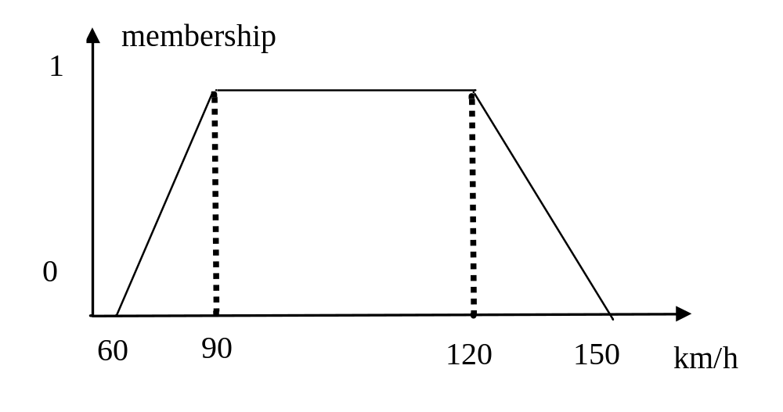
Membership Functions: Example
© 2007 Cios / Pedrycz / Swiniarski / Kurgan

Slide 30
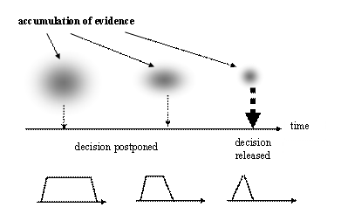
Principle of the Least Commitment
© 2007 Cios / Pedrycz / Swiniarski / Kurgan

Slide 31
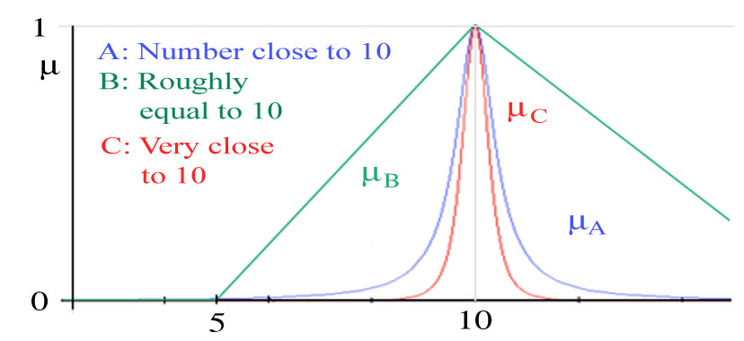
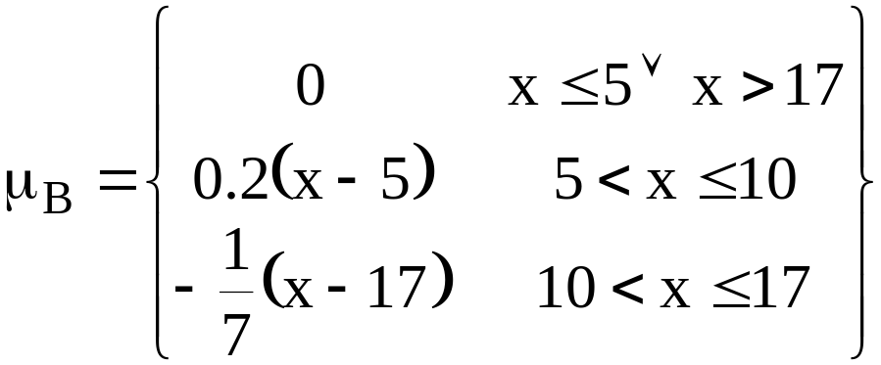
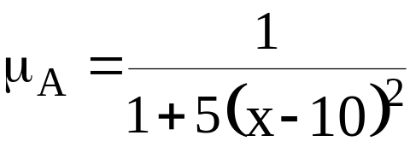
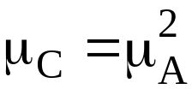
From Koczy
Crisp set | Fuzzy set
Characteristic function | Membership function
μ_{A}:X→{0, 1} | μ_{A}:X→[0, 1]

Slide 32

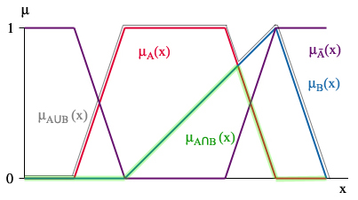
Complement:
Intersection:
Union:

Slide 33
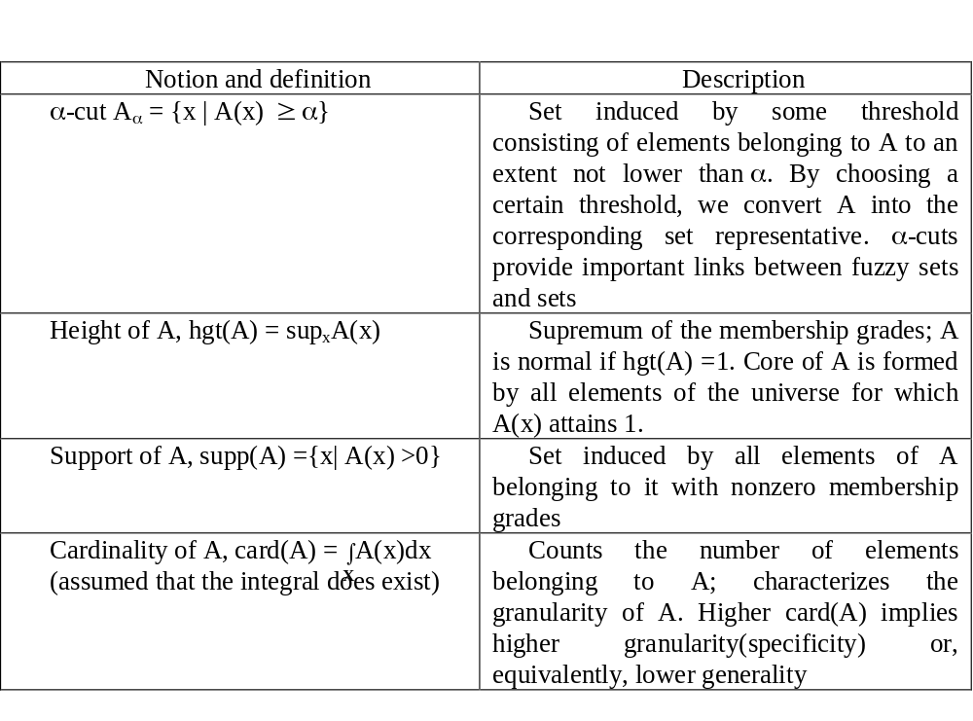
Characteristics of Fuzzy Sets
© 2007 Cios / Pedrycz / Swiniarski / Kurgan

Slide 34
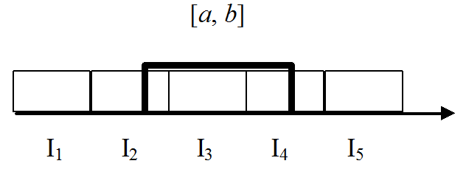
Rough Sets
Defining concept X with the use of a finite vocabulary of information granules:
Lower bound (approximation)
Upper bound (approximation)
© 2007 Cios / Pedrycz / Swiniarski / Kurgan

Slide 35
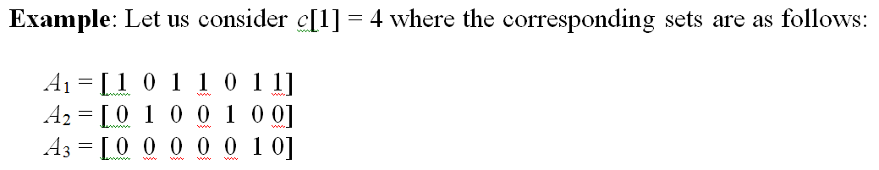

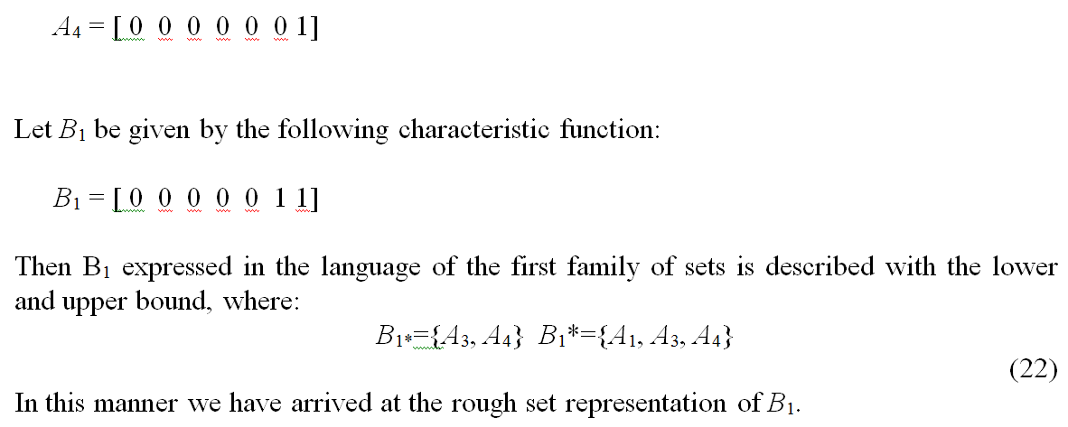
© 2007 Cios / Pedrycz / Swiniarski / Kurgan

Slide 36
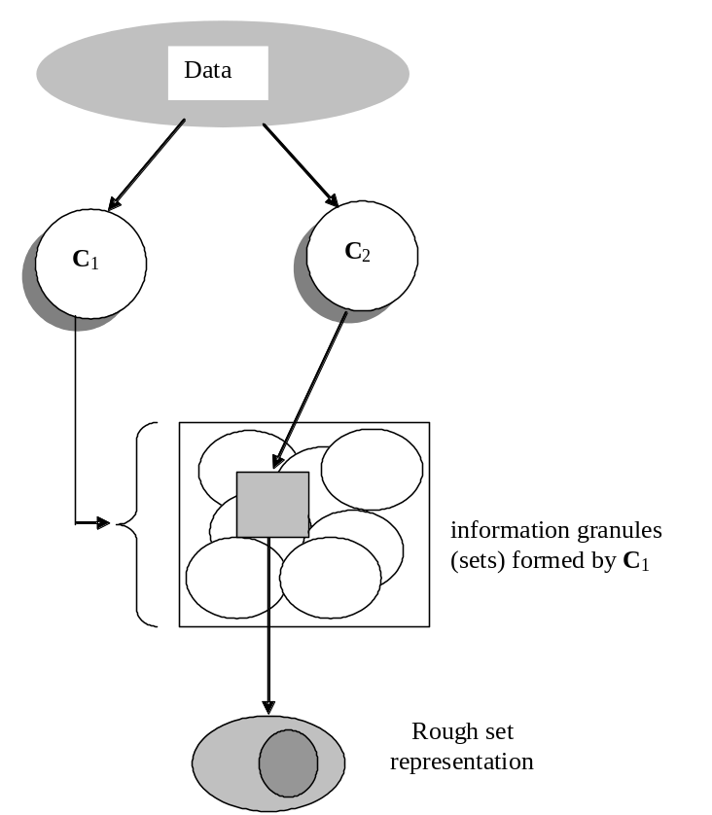
Rough Sets: The Principle of Data Description
Given some information granules they are used to characterize other
granular view of data
© 2007 Cios / Pedrycz / Swiniarski / Kurgan

Slide 37
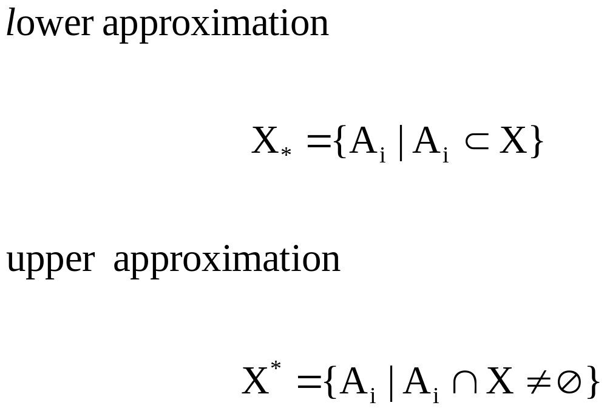
Rough Sets: Upper and Lower Approximations
© 2007 Cios / Pedrycz / Swiniarski / Kurgan

Slide 38
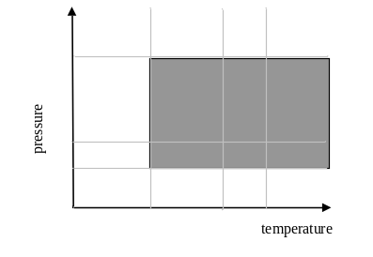
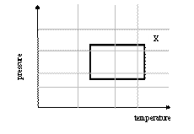
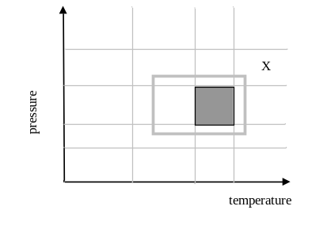
Rough Sets: Upper and Lower Approximations
A_{i}
upper approximation
lower approximation
© 2007 Cios / Pedrycz / Swiniarski / Kurgan

Slide 39
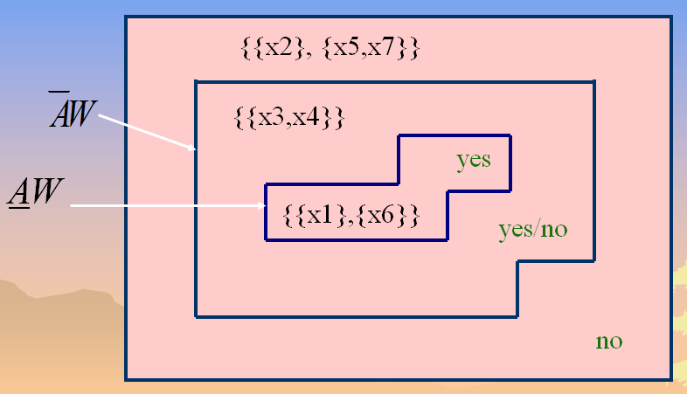
from Ras

Slide 40
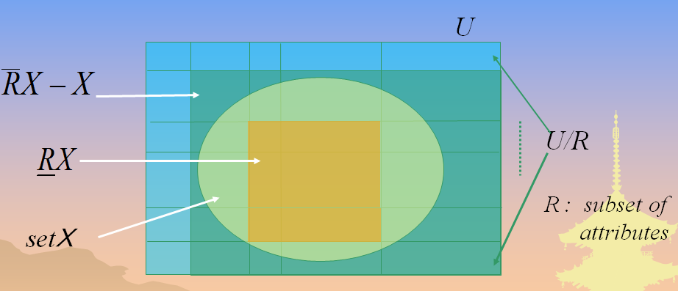

Slide 41
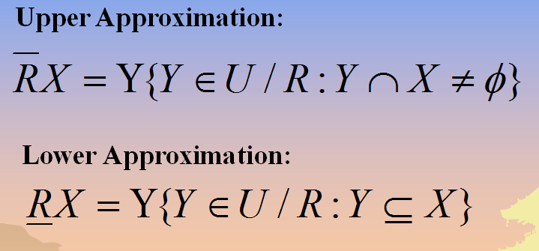

Slide 42
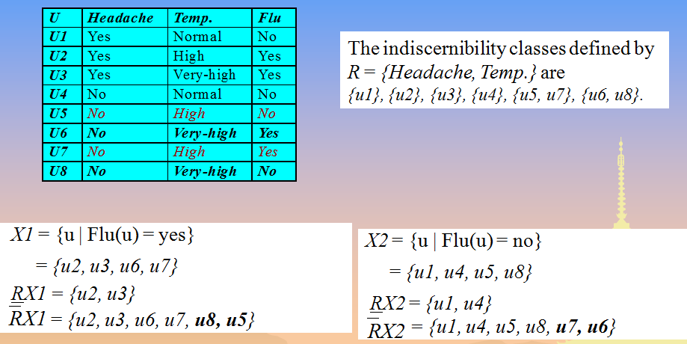

Slide 43
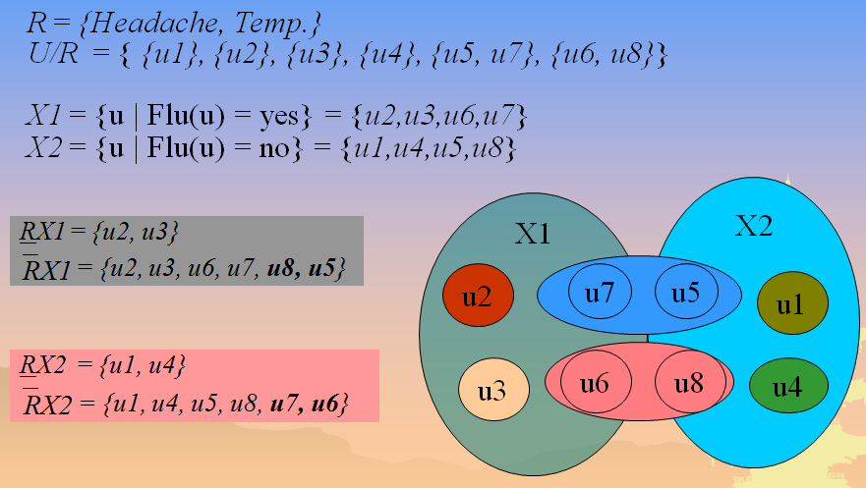

Slide 44
Characterization of Knowledge Representation Schemes
Expressive power of the scheme
Computational complexity and tradeoffs:
- Flexibility of knowledge representation (KR) – familiarity of the users
with a specific scheme of KR
- Effectiveness of forming models on the basis of domain knowledge
and experimental data
Character of information granulation and level of specificity of
information granules
© 2007 Cios / Pedrycz / Swiniarski / Kurgan

Slide 45

Information Granularity
Information granules are defined at different levels of specificity
(abstraction) which is reflective of their “size”
Measures that characterize the size of information granules
Information granules | Granularity
Fuzzy sets | In the case of a finite space X, the integral is replaced by a sum of the membership grades
Rough sets | Cardinality of the lower and upper bound, card (A₊), card (A₋); the difference between these two describes roughness of A
© 2007 Cios / Pedrycz / Swiniarski / Kurgan

Slide 46
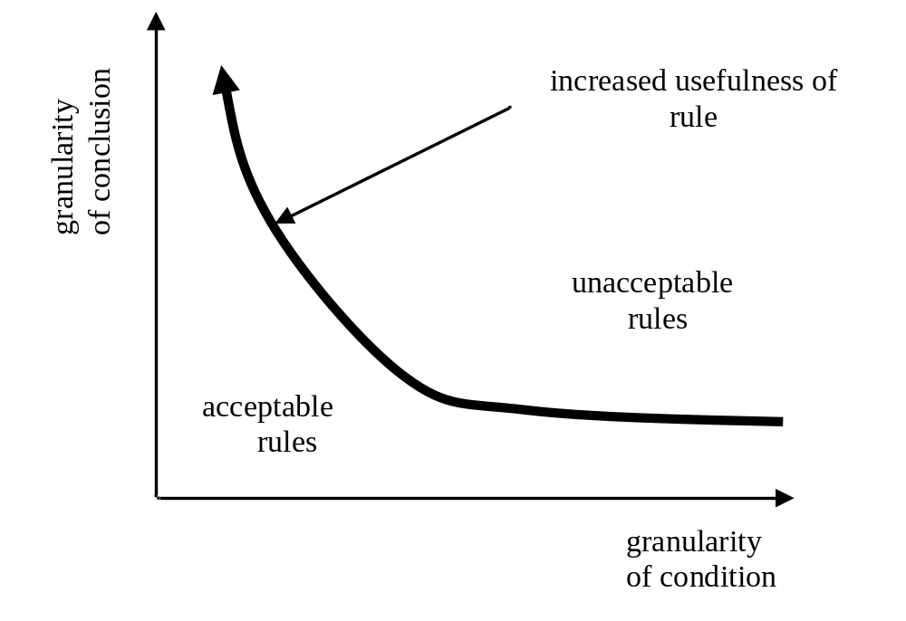
Information Granularity in Rule-based Systems
© 2007 Cios / Pedrycz / Swiniarski / Kurgan

Slide 47
References
Bargiela A and Pedrycz W. 2003. Granular Computing: An Introduction,
Kluwer Academic Publishers
Giarratano J and Riley G. 1994. Expert Systems: Principles and Programming,
2nd Ed., PWS Publishing
Moore R. 1966. Interval Analysis, Prentice Hall
Pal SK and Skowron A (eds.) 1999. Rough Fuzzy Hybridization.
A New trend in Decision-Making, Springer Verlag
Pawlak Z. 1991. Rough Sets. Theoretical Aspects of Reasoning About Data,
Kluwer Academic Publishers
Pedrycz W and Gomide F. 1998. An Introduction to Fuzzy Sets; Analysis and Design.
MIT Press, 1998.
Pedrycz W (ed.). 2001. Granular Computing: An Emerging Paradigm, Physica Verlag
Zadeh LA. 1965. Fuzzy sets, Information & Control, 8, 1965, 338-353.
© 2007 Cios / Pedrycz / Swiniarski / Kurgan

